Slide 1


Report on Crude Oil Import Forecasting for Eagle Energy Enterprises from 2009 - 2022
Eagle Energy Enterprises refines crude oil into gasoline, diesel, and other fuels. Forecasting crude oil imports is crucial for optimizing operations and mitigating risk.
by IBOR STELLA
IS

Slide 2
Understanding Eagle Energy’s Challenges
Core Business
Challenge
Refining crude oil into gasoline, diesel, and other fuels.
Volatility in crude oil imports affects inventory management, production planning, and profitability.

Slide 3

Why We Need a Forecasting System
Enhanced Decision-Making
Informed decisions based on accurate forecasts.
Operational Efficiency
Streamlined operations with predictable supply.
Risk Mitigation
Reduce impact of price fluctuations.
Improved Procurement
Timely purchases at favorable prices.

Slide 4
Forecasting Models We Evaluated
Naive Approach
Moving Average
Exponential Smoothing
Simple Linear Regression
Simple baseline model, assumes current import levels will continue.
Averages past data points to predict future imports.
Weights recent data more heavily for better accuracy.
Identifies trends in historical data to predict future imports.

Slide 5
Result Of The Four Approaches Used
Approaches | MAD | MSE | MAPE | Accuracy
Naïve Approach | 13,342 | 13,342 | 5.8% | 94%
Moving Average | 11,269 | 214,576,195 | 5.0% | 95%
Exponential Smoothing | 11,883 | 251,393,654 | 5.2% | 95%
Simple Linear Regression | 16,104 | 377,304,129 | 6.1% | 93%

Slide 6
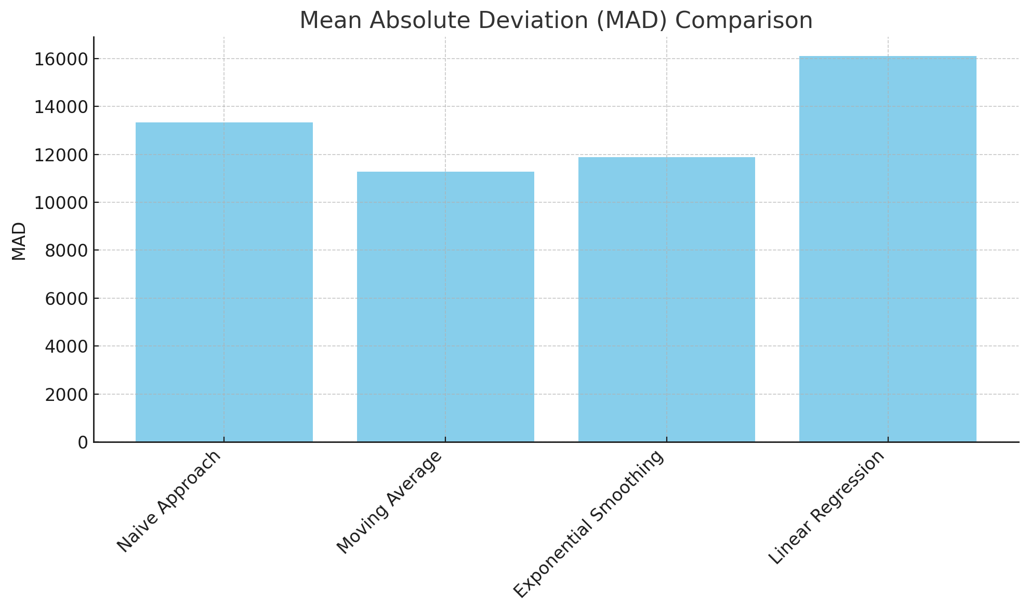
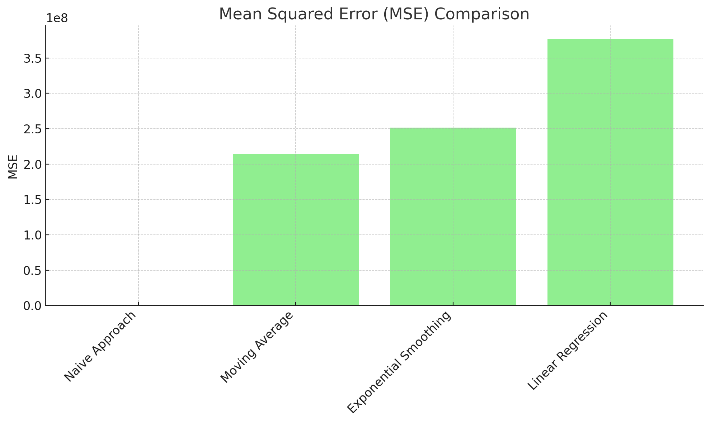
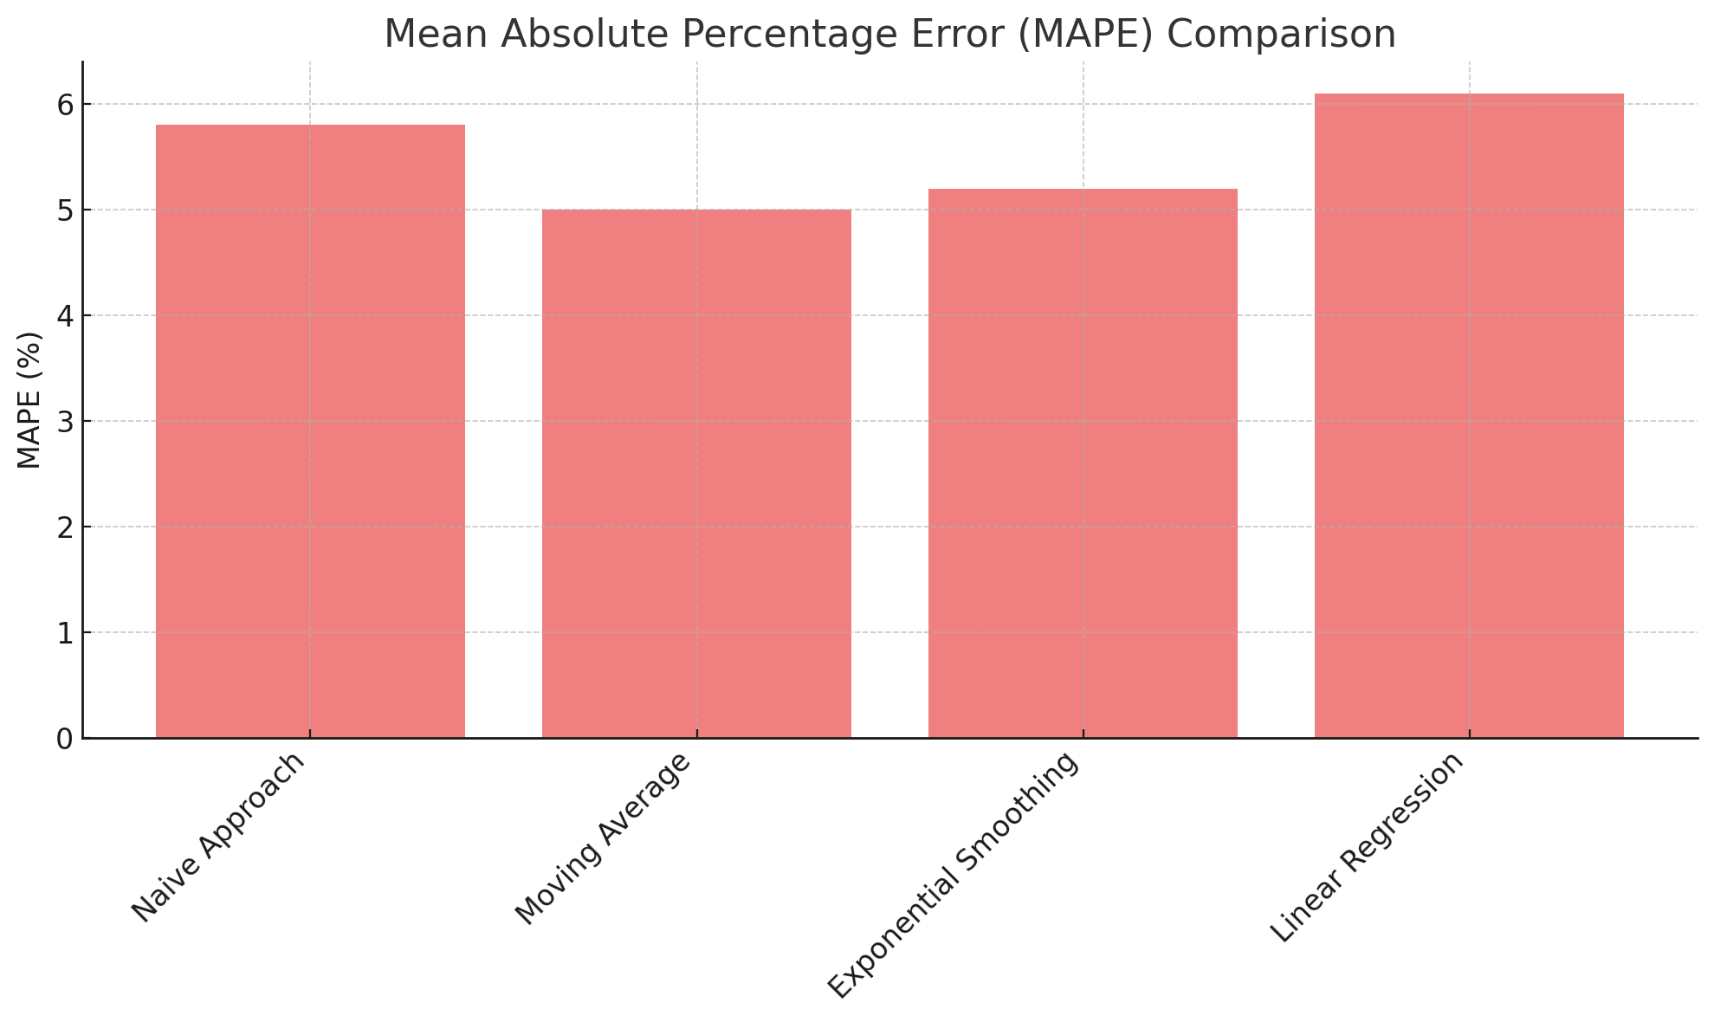
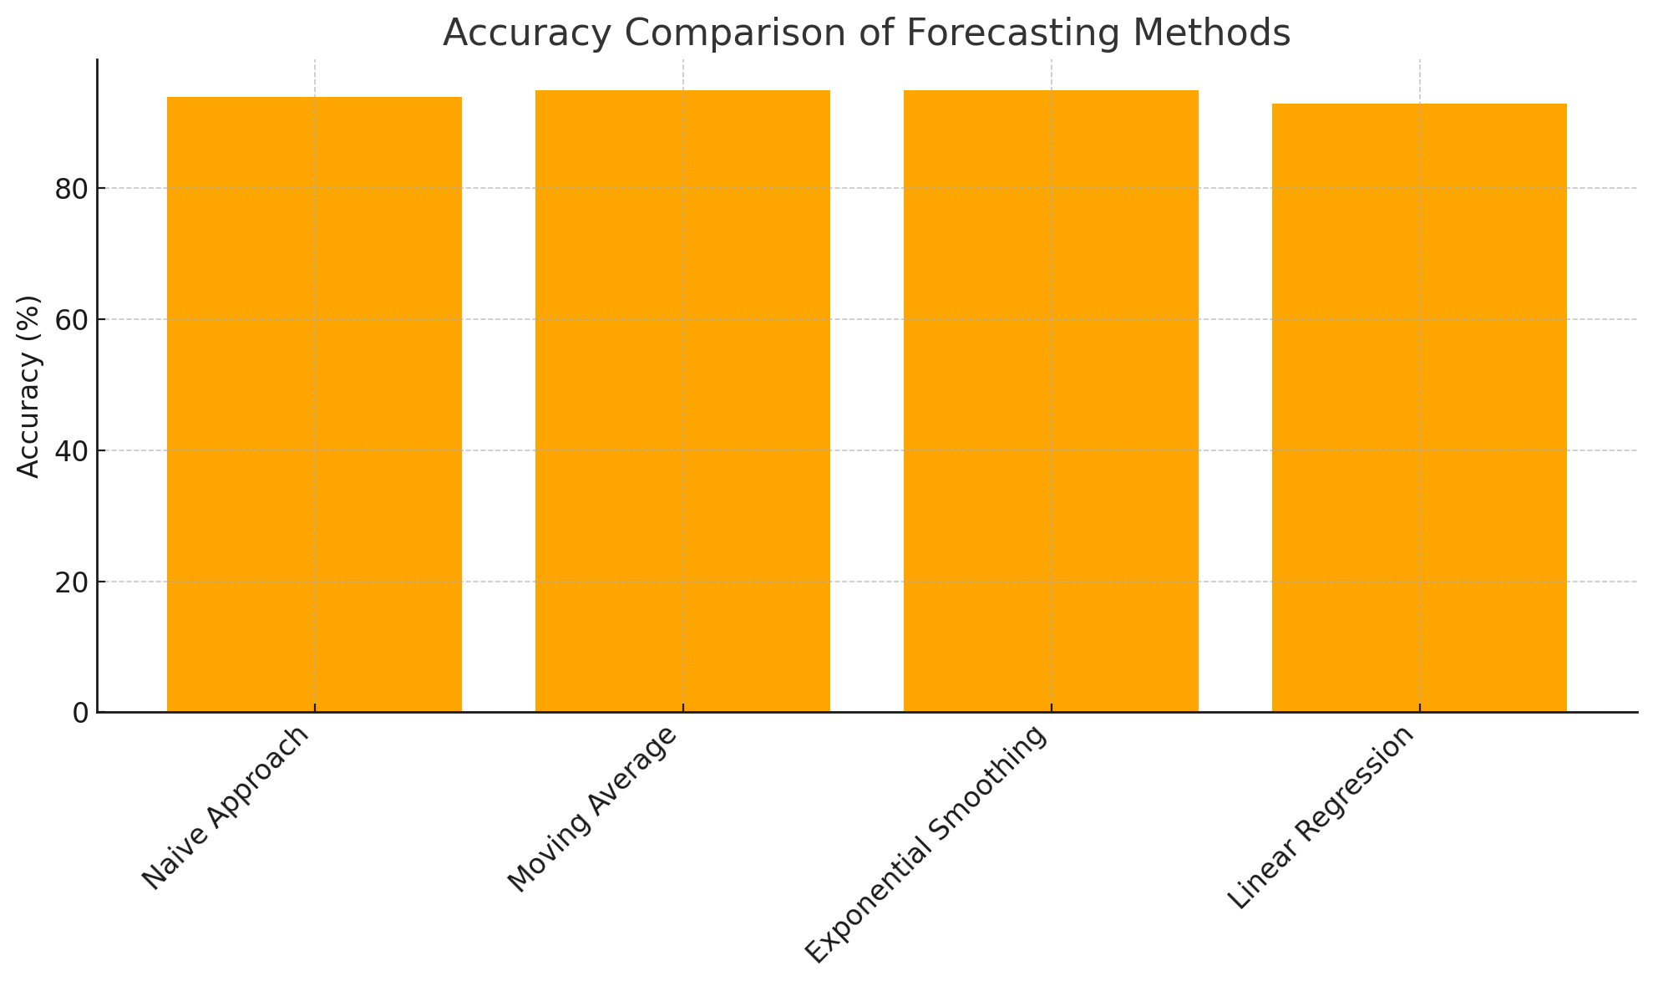
Performance of Forecasting Methods
Mean Absolute Deviation
Mean Squared Deviation
Mean Squared Error
MAPE
Accuracy
MAPE
Accuracy
Mean Absolute Percentage Error
Overall accuracy of the model

Slide 7
Why Moving Average is the Best Option?
Actual Imports
Moving Average Forecast
Represents the actual crude oil imports over time.
Predicts future imports based on past data.
Moving Average is the best-performing method, capturing overall trends while minimizing errors.

Slide 8

Strategic Benefits of Forecasting
Optimized Inventory Management
Better stock control, avoiding overstock or shortages.
Improved Production Planning
Aligning production with forecasted crude oil availability.
Cost Savings
Timely procurement decisions to secure favorable prices.
Reduced Risk
Anticipating volatility and avoiding sudden cost increases.

Slide 9


Conclusion and Implementation Plan
1
Automate Data Collection
Real-time import data.
2
Integrate Forecasting System
Implement Moving Average into operational planning.
3
Monitor and Improve
Regularly update forecasts and adjust based on market conditions.

Slide 10

LinkedIn Profile
iboraboghenestella@gmail.com

